Slide 1


Understanding Logic Gates
Logic gates are the fundamental building blocks of digital circuits.

Slide 2
Learning Outcome
1. Basic Functions: Understand operations of AND, OR, NOT, and other gates.
2. Circuit Design: Design and analyze simple digital circuits using logic gates.
3. Error Detection: Apply logic gates in error detection and correction techniques.
4. Digital Systems: Recognize the role of logic gates in computers and digital devices.

Slide 3


The Importance of Logic Gates
1
Digital Electronics
Logic gates form the basis of all digital devices, from computers to smartphones.
2
Complex Circuits
Combining logic gates allows for the creation of circuits that perform arithmetic, make decisions, and process data.
3
Widespread Impact
Logic gates are essential to the functioning of modern digital technology.

Slide 4

What role does logic gates play in the cybersecurity?
Implementing the right combination of logic gates helps create robust security protocols that protect sensitive information from cyber threats. Following are few examples :-
AND gate can be employed in multi-factor authentication systems, where a user must provide both a password and a verification code to gain access, thus reducing the risk of unauthorized access.
XOR gates are commonly used in encryption algorithms to mix plaintext with a key, making it difficult for attackers to decipher the data without the correct key. Logic gates also play a crucial role in intrusion detection systems.
OR gates allows the system to trigger an alert if any one of several suspicious activities is detected, improving response times to potential threats.

Slide 5
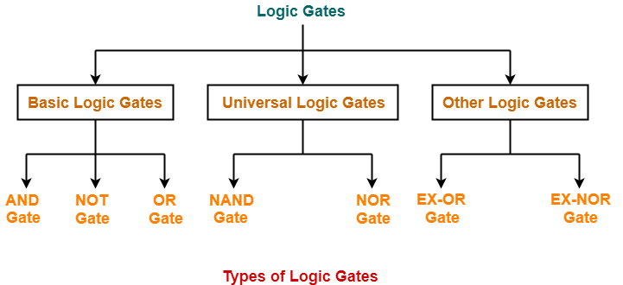
The Logic Gates Hierarchy Chart

Slide 6
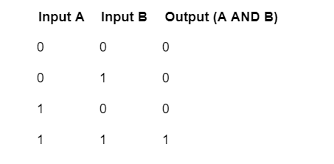
Basic Logic Gates
1. AND Gate
Function:
The AND gate takes two inputs and
produces one output.
It outputs 1 only when both inputs are 1.
If either input is 0, the output is 0.
Why It Works This Way:
The AND gate represents the logical operation "AND" meaning both conditions must be true for the result to be true. This is like a requirement in programming where two conditions must be met simultaneously.
Example:
If you’re programming a game and want a character to jump only if both "spacebar is pressed" and "character is on the ground," the AND logic ensures both conditions are true before the character jumps.

Slide 7
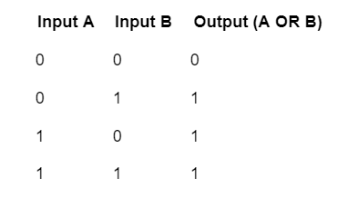
2. OR Gate
Function:
The OR gate also takes two inputs and produces one output.
It outputs 1 if at least one of the inputs is 1. The only time it outputs 0 is when both inputs are 0.
Why It Works This Way:
The OR gate represents the logical operation "OR," meaning either or both conditions can be true for the result to be true. This is useful when any one of several conditions can trigger an action.
Example:
In an email application, the OR logic can be used to notify you if a new email arrives or if a scheduled time to check for emails has passed. Either event will trigger the same notification.

Slide 8
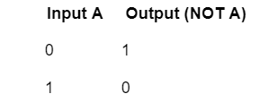
3. NOT Gate
Function:
The NOT gate is unique because it only takes one input and produces one output.
It inverts the input: if the input is 1, the output is 0, and if the input is 0, the output is 1.
Why It Works This Way:
The NOT gate represents the logical operation "NOT," meaning it negates or inverts the input. This is useful when you need the opposite of a condition.
Example:
If a security system is armed (1), a NOT gate could be used to turn off a warning light (0), indicating that no further action is needed.

Slide 9

Why do we combine logic gates?
Complex Decisions
Combining gates allows computers to make complex decisions based
on multiple conditions.
Arithmetic Operations
Logic gate combinations enable arithmetic operations like
addition and subtraction.
Data Storage
Memory in computers uses gate combinations to store bits of data.

Slide 10





The Impact of Bit Flips
The meaning of data changes dramatically if a single bit is reversed (i.e., a 0 becomes 1 or vice versa).
Flipping a single bit can change a character's ASCII code.
Text
Bit flips can drastically alter the value of a binary number.
Numbers
Bit errors can change the color of individual pixels.
Images
Bit flips in machine instructions can lead to unexpected behavior.
Instructions

Slide 11
Importance of Accuracy
Why It Matters:
Data Integrity: Inaccurate data storage or transmission can lead to corrupted files, miscommunication, or malfunctioning software.
Security: Flipping a bit in a security key or password can invalidate access, rendering a system secure or insecure depending on the context.
Control Systems: In critical systems, like those in healthcare or aviation, a single bit error could have severe consequences.
Error Detection and Correction:
To prevent bit errors, computers use techniques like parity bits or checksums to detect and sometimes correct errors in data.

Slide 12
Activities
Let's Look at the implementation of logic gates in Tinkercad and also in on actual bread board

Slide 13
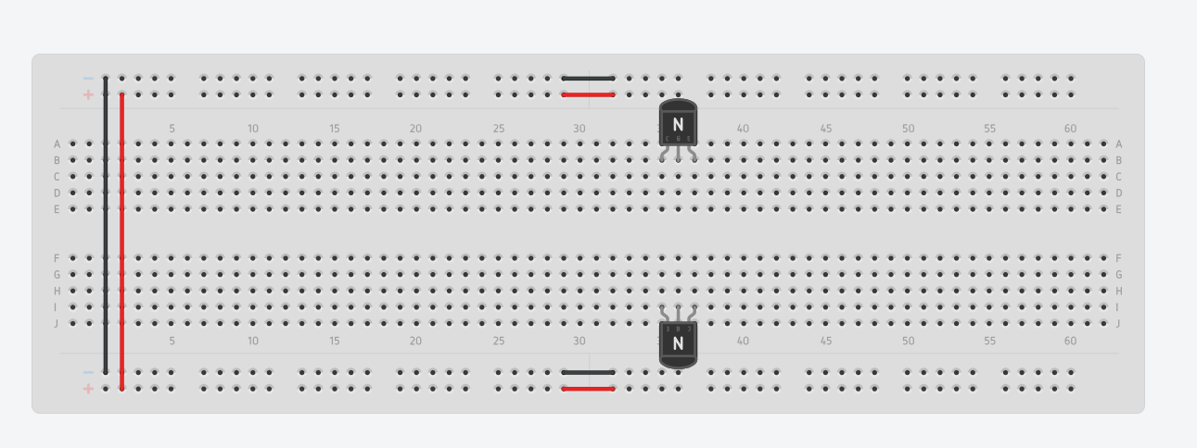
AND Gate - Step 1
An NPN transistors a device that uses a small current to control a larger current, acting like a switch or amplifier in electronic circuits.
Open Tinkercad and select the Circuit Option.
Then take 2 NPN Transistors and connect it in the breadboard

Slide 14
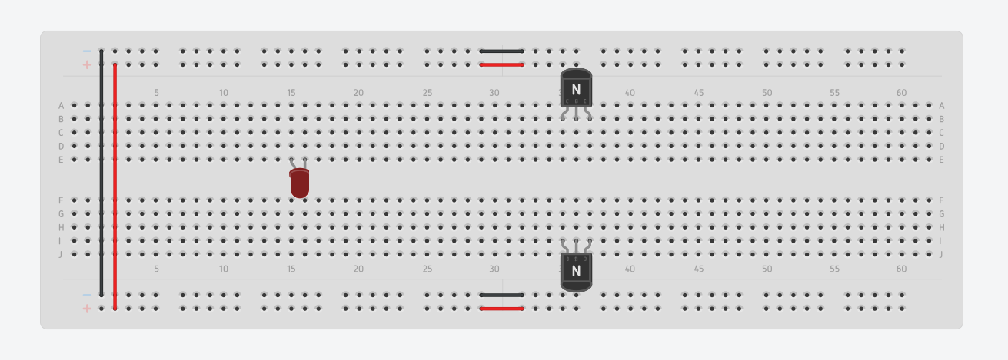
AND Gate - Step 2
An LED (Light Emitting Diode) is a small electronic device that lights up when electricity flows through it, producing bright light in various colors.
2. Connect the LED to the breadboard

Slide 15
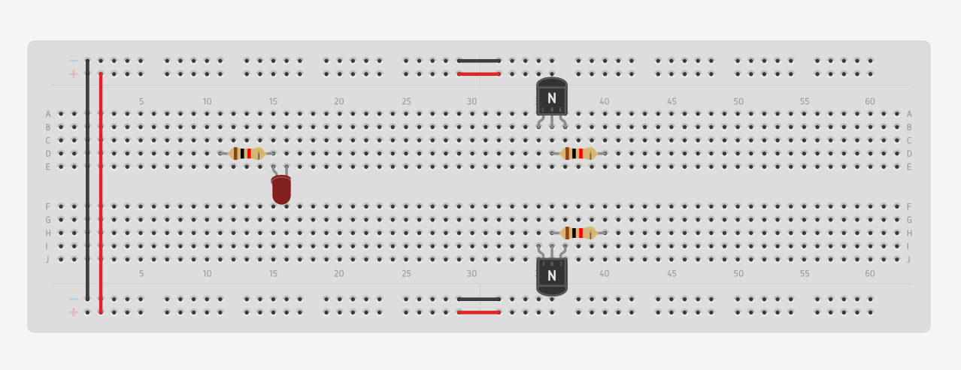
AND Gate - Step 3
A resistor is an electronic component that reduces the flow of electric current in a circuit, helping to control voltage and current levels.
3.1 Connect one resistor to the positive terminal of the LED.
3.2 and connect 2 resistors to the base terminal of the transistor.

Slide 16
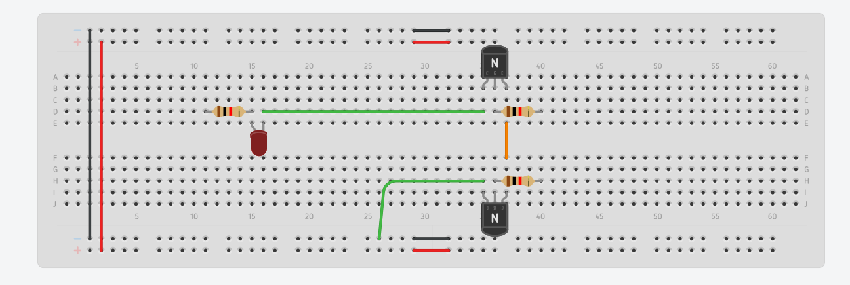
AND Gate - Step 4
4.1 Take a wire to connect the negative terminal of the led to the emitter pin of the transistor.
4.2 Connect the collector pin to the negative terminal of the breadboard.
4.3 Finally, connect a wire connecting the emitter pin to the collector terminal of the other transistor.

Slide 17
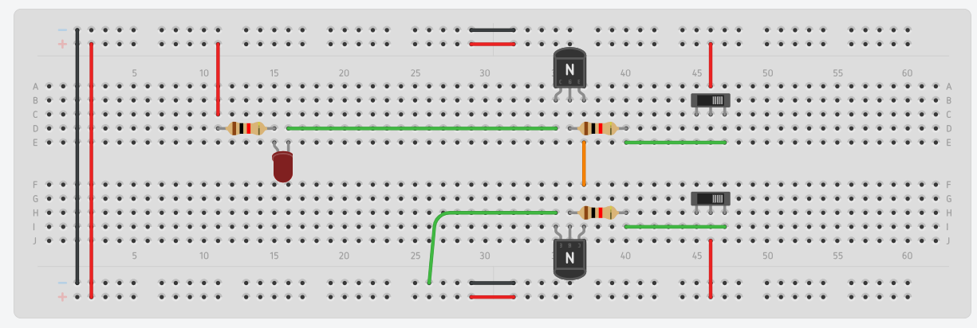
AND Gate - Step 5
5.1 Connect the 2nd terminal of the switches to the positive terminal of the breadboard.
5.2 Then connect the resistor to the positive terminal of the breadboard.
5.3 Also connect the resistor to the 3rd terminal of the switch.

Slide 18
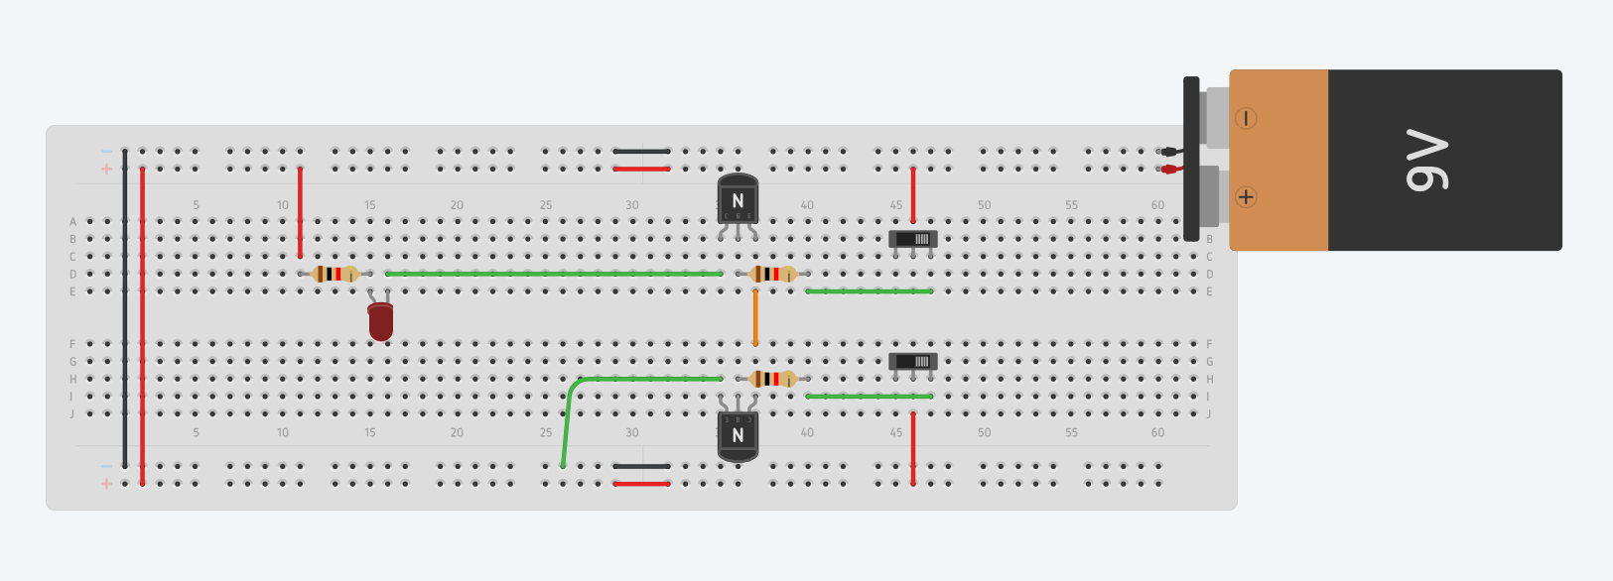
AND Gate - Step 6
6 Connect Battery to the Breadboard

Slide 19
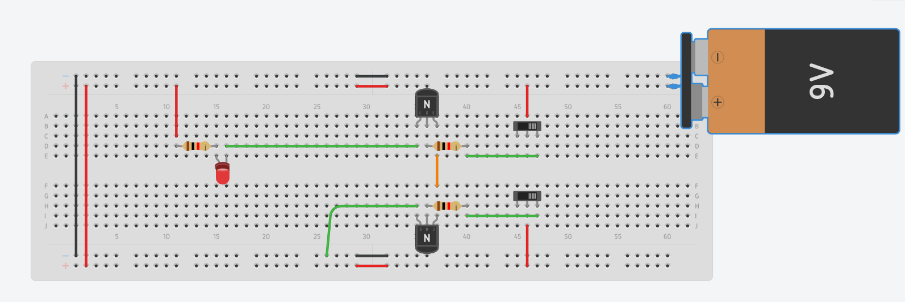
AND Gate - Final Output The Blinking Light

Slide 20
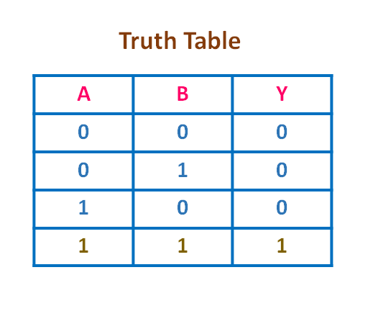


Logic behind the connections in case of AND Gate
If both Switch A and Switch B are OFF (0) → LED is OFF.
If Switch A is OFF (0) and Switch B is ON (1) → LED is OFF.
If Switch A is ON (1) and Switch B is OFF (0) → LED is OFF.
If Switch A is ON (1) and Switch B is ON (1)
→ LED is ON.

Slide 21
Or Gate
Output

Slide 22
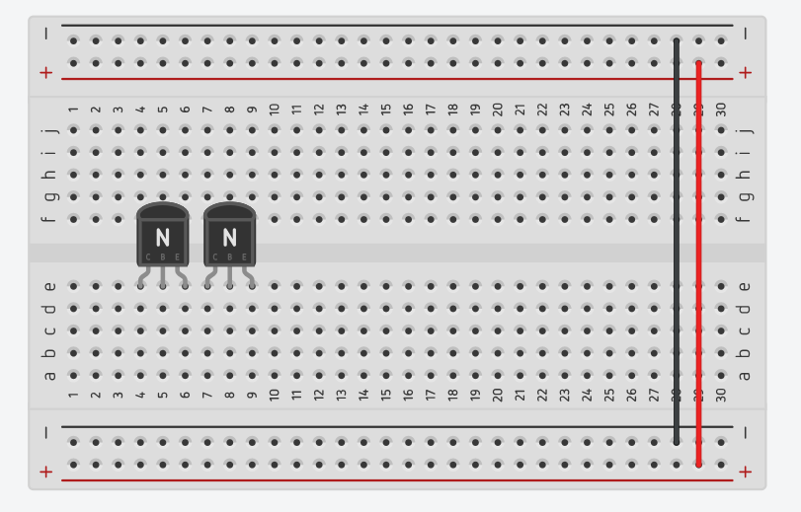
OR Gate - Step 1
Open Tinkercad and select the Circuit Option.
Then take 2 NPN Transistors and connect it in the breadboard

Slide 23
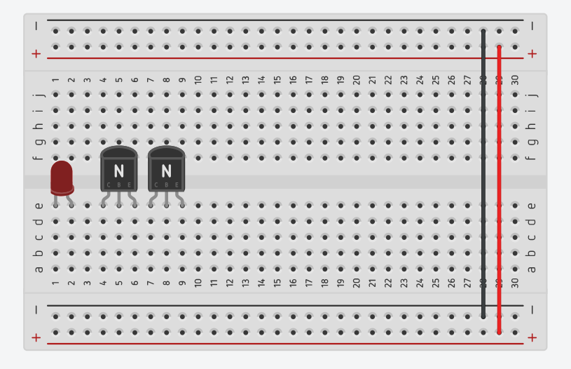
OR Gate - Step 2
2. Connect the LED to the breadboard

Slide 24
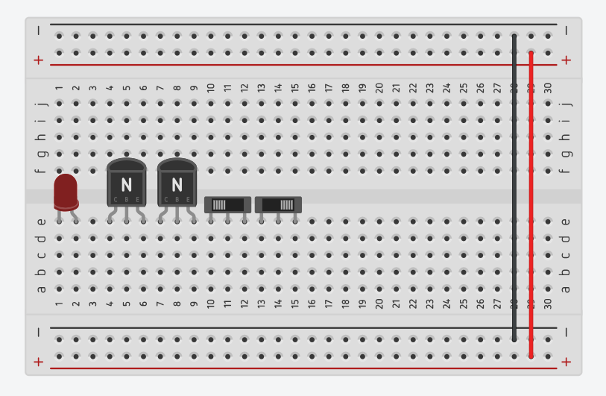
OR Gate - Step 3
3.1 Connect 2 Switches to the breadboard

Slide 25
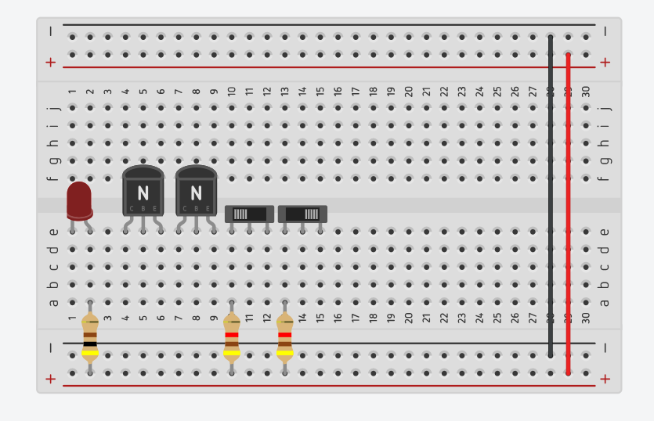
OR Gate - Step 4
Use 1k or 220 or 330 ohm resistors
4.1 Connect one resistor to the positive terminal of the LED and the other to the Positive terminal.
4.2 and connect 2 resistors to the 1st terminal of the switch and the other end on the positive terminal of the breadboard.

Slide 26
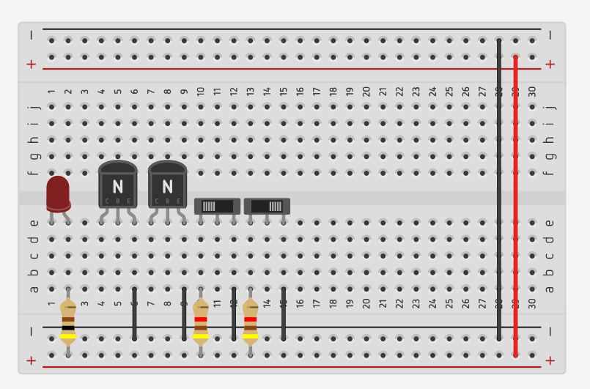
OR Gate - Step 5
5.1 Connect the Emitter terminal of the transistors to the negative terminal of the breadboard.
5.2 Connect the 3rd terminal of the switches to the negative terminal of the breadboard.

Slide 27
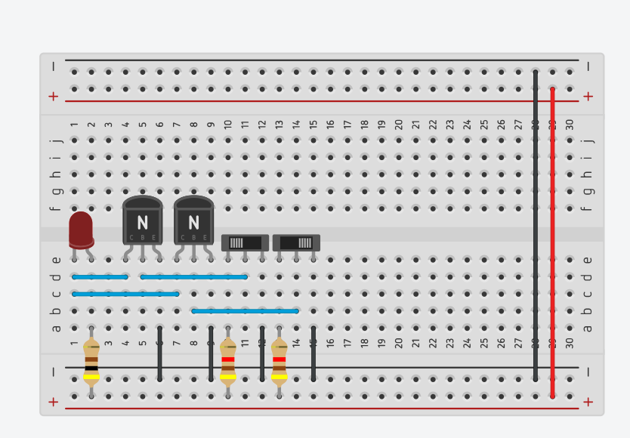
OR Gate - Step 6
6.1 Connect the negative pin to the collector pin of the transistors
6.2 Connect the 2nd pin of the switches to the base terminal of the transistors.

Slide 28
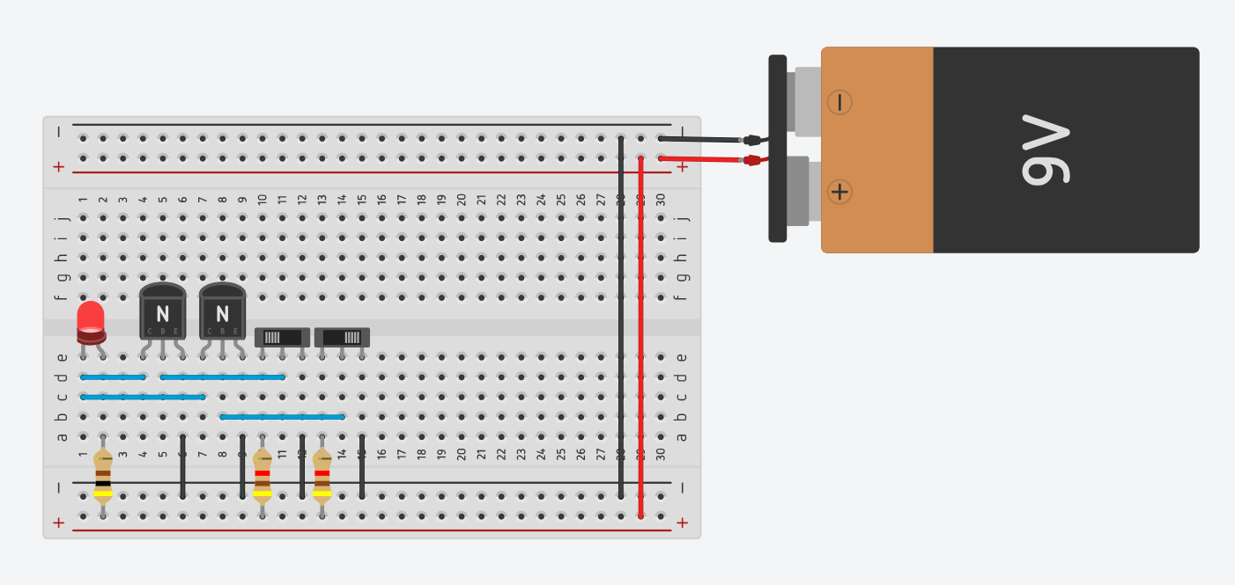
OR Gate - Step 6
6.1 Connect battery to the breadboard and our circuit is complete

Slide 29
Logic behind the connections in case of Or Gate
If both Switch A and Switch B are OFF (0) → LED is OFF.
If Switch A is OFF (0) and Switch B is ON (1) → LED is ON.
If Switch A is ON (1) and Switch B is OFF (0) → LED is ON.
If Switch A is ON (1) and Switch B is ON (1) → LED is ON.

Slide 30
Homework
Implement NOT gate in Tinkercad
State the components required for the same?

